Slide 1

Falcon 9 First-Stage Landing Prediction — Capstone Technical Report
Analyzing data to forecast rocket landing success
RICARDO YUKIO MATSUO
30/09/2025 https://github.com/Landtrap/spacex-falcon9-capstone

Slide 2
Meeting Program
Cover
Executive Summary
Introduction
Data Collection (API)
Data Collection (Web Scraping)
Data Cleaning & Sampling
Variable Dictionary
Exploratory Data Analysis — Trends
Exploratory Data Analysis Using SQL
Notes:
We will begin with the cover details and executive summary, followed by the introduction to the problem. Then, we'll discuss data collection methods, data cleaning and sampling, variable definitions, exploratory data analysis, and conclude with key findings.

Slide 3

Cover
Notes:
This section presents the report title, author details, and the date of the analysis, establishing the formal context for this technical study.

Slide 4

Falcon 9 First-Stage Landing Prediction
Landing Success Prediction
Predicting first-stage landing success helps improve mission reliability and reduces overall costs.
Cost Optimization
Successful reuse of Falcon 9 first stages lowers launch expenses and supports sustainable space missions.
Notes:
The project focuses on predicting the success of Falcon 9 first-stage landings, crucial for cost optimization through vehicle reuse.

Slide 5

Author: [PLACEHOLDER]
Author Attribution
This section provides details to properly attribute the work to its author, ensuring recognition.
Contact Details
Includes contact information for further communication or inquiries related to the presented work.
Notes:
Author information will be specified here to attribute the work appropriately and provide contact details.

Slide 6

Date: 30/09
The report date indicates when the analysis and findings were completed, establishing the timeline.
Notes:
The date of this report marks the timeline of the conducted analysis and findings.

Slide 7

Goal: Predict first-stage landing to improve reusability and reduce costs
Data Sources: SpaceX REST API and Wikipedia web scraping focused on Falcon 9
Methods: SQL queries, visual exploratory data analysis, Folium maps, Plotly Dash
Machine Learning: Models include Logistic Regression, SVM, Decision Trees, KNN with GridSearchCV
Key Findings: Landing success has risen since 2013 and depends on launch site, orbit, and payload mass
Actions: Focus on high-probability landings and integrate weather data for better planning
Executive Summary
Notes:
An overview of the problem, methodology, key findings, and recommendations is provided to summarize the report's essence.

Slide 8

Problem: Predicting Success of First-Stage Landing
Landing Prediction Challenge
Accurately predicting the success of rocket first-stage landing is critical for mission planning and cost efficiency.
Impact on Mission Cost
Successful landing predictions help reduce mission costs by enabling reuse of the rocket's first stage.
Scheduling Considerations
Accurate landing forecasts support effective mission scheduling and resource allocation.
Notes:
The main challenge is to accurately predict if the Falcon 9 first stage will successfully land, impacting mission cost and scheduling.

Slide 9

Method: Data Analysis and Supervised Machine Learning
Data Analysis Techniques
Utilized data analysis to examine launch data and extract meaningful patterns and trends.
Supervised Machine Learning
Applied supervised machine learning models to predict outcomes based on labeled training data.
Predictive Insights
Derived predictive insights to improve decision-making from the analyzed launch data.
Notes:
We employed data analysis techniques and supervised machine learning models to derive predictive insights from launch data.

Slide 10

Findings: Accuracy Over 80%, Orbit and Launch Site Relevant, Temporal Bias
High Model Accuracy
Models achieved over 80% accuracy, demonstrating strong predictive performance.
Orbit and Launch Site Importance
Orbit and launch site were identified as key features impacting model predictions.
Temporal Bias Detected
The data showed a temporal bias, indicating time-related inconsistencies in the dataset.
Notes:
The models achieved over 80% accuracy, highlighting orbit and launch site as important features, but revealed a temporal bias in the data.

Slide 11

Recommendations: Include Weather Data and Calibrate Probabilities
Incorporate Weather Data
Integrate weather factors to enhance the accuracy and context of predictive models.
Calibrate Probabilities
Adjust prediction probabilities to improve reliability and decision-making confidence.
Notes:
Future work should incorporate weather factors and calibrate prediction probabilities for improved reliability.

Slide 12

Introduction
Notes:
This section introduces the Falcon 9's reusable first-stage capabilities and the importance of landing success prediction for cost optimization and operational planning.

Slide 13

Falcon 9 Reduces Costs via First-Stage Reuse
First-Stage Reuse Benefits
Reusing the first stage of rockets drastically lowers launch expenses and maximizes resource efficiency.
Landing Success Importance
Achieving reliable landings is essential for cost savings and measuring operational success in space missions.
Impact on Space Industry
Reusable launch technology is transforming space industry economics by making access to space more affordable.
Notes:
By reusing the first stage, Falcon 9 significantly cuts launch costs, making landing success a critical business metric.

Slide 14

Landing Prediction Optimizes Cost Estimation
Accurate Landing Forecasting
Precise prediction of landing outcomes enhances the reliability of mission planning and execution.
Cost Assessment Improvement
Forecasting landing results helps optimize budget allocation and reduce unexpected expenses.
Risk Management Enhancement
Accurate landing predictions allow better identification and mitigation of mission risks.
Notes:
Accurately forecasting landing outcomes aids in precise cost assessments and mission risk management.

Slide 15

Justification: Support Decision-Making and Planning
Operational Decision Support
The predictive model assists in making informed operational decisions to improve launch program efficiency.
Scheduling Optimization
The model helps optimize scheduling to ensure launch timelines are met effectively.
Resource Allocation
Efficient allocation of resources is supported by the predictive model to maximize mission success.
Notes:
The predictive model supports operational decisions, scheduling, and resource allocation within SpaceX launch programs.

Slide 16

Cost Reduction Through Falcon 9 Reuse
Falcon 9 launch costs approximately $62 million compared to competitors' $165 million.
Reusability of the first stage significantly drives down launch expenses.
Can public data predict landing success to enhance mission reliability?
Predictive insights support pricing strategies and bid competitiveness.
Improved landing forecasts aid in efficient mission planning and resource allocation.
Notes:
Falcon 9's reusable first stage lowers costs dramatically compared to other launch providers. This slide explores whether public data can be leveraged to predict landing success, which is crucial for pricing bids and planning missions more effectively. Accurate predictions help reduce financial risks and optimize scheduling and resource management for space missions.

Slide 17
Data Collection (API)
Notes:
We collected structured launch data from SpaceX's public API to capture detailed information about past launches.

Slide 18

Using Endpoint /v4/launches/past
API Endpoint Purpose
The /v4/launches/past endpoint retrieves detailed records of previous launches in JSON format.
Rich Metadata
The retrieved JSON includes extensive metadata providing comprehensive launch details for analysis.
Notes:
The API endpoint /v4/launches/past was used to retrieve JSON records of previous launches with rich metadata.

Slide 19

Extracting Key Variables from JSON
Launch Site Data
Extracting launch site information is essential to analyze mission origins and logistics.
Orbit Type Identification
Capturing orbit type helps categorize satellite missions and their trajectories.
Payload Mass Analysis
Payload mass is a critical parameter influencing launch vehicle performance and mission planning.
Landing Outcome Tracking
Recording landing outcomes assists in assessing mission success and reusability factors.
Notes:
Relevant variables such as launch site, orbit type, payload mass, and landing outcome were extracted for analysis.

Slide 20

Normalizing Structured Data
Consistent Variable Formats
Normalization standardizes variable formats to ensure data consistency across datasets.
Machine Learning Readiness
Normalized data is primed for integration into machine learning pipelines for accurate analysis.
Notes:
Data normalization ensured consistent variable formats and readiness for machine learning pipelines.

Slide 21

Data Collection Using SpaceX API Endpoints
Utilized /v4/launches/past endpoint combined with rockets, payloads, cores, and launchpads lookups.
Extracted and normalized JSON data into structured tables using json_normalize techniques.
Joined datasets by unique IDs to enrich features including launch outcome, site, orbit, payload mass, and core information.
Data coverage spans multiple years with comprehensive record counts supporting robust analysis.
Notes:
This slide details the data collection methodology leveraging SpaceX's REST API. The /v4/launches/past endpoint provides historical launch data enriched by related endpoints such as rockets, payloads, cores, and launchpads. The raw JSON data was normalized into tabular formats for ease of analysis. Combining these datasets by IDs allows for a comprehensive feature set essential for accurate predictive modeling.

Slide 22

Data Collection (Web Scraping)
Notes:
Additional data was gathered via web scraping to supplement API data and enhance dataset completeness.

Slide 23

Using BeautifulSoup for Table Scraping
BeautifulSoup Library Usage
BeautifulSoup is a Python library used to parse HTML and scrape data from web pages efficiently.
Scraping Launch Tables
Launch tables from Wikipedia and SpaceX tracking sites were scraped to collect accurate launch information.
Cross-Verification Process
Data from multiple sources was cross-verified to ensure accuracy and reliability of the scraped information.
Notes:
We used BeautifulSoup to scrape launch tables from Wikipedia and SpaceX tracking websites for cross-verification.

Slide 24

Sources: Wikipedia, SpaceX Tracking
Multiple Data Sources
Using multiple sources enhances the richness and reliability of collected launch data.
Improved Validation
Cross-referencing data from several sources improves the accuracy of launch details.
Notes:
Multiple sources ensured richer data coverage and improved validation of launch details.

Slide 25

Cross-Validation and Dataset Fusion
Data Cross-Validation
Scraped and API datasets were cross-validated to ensure accuracy and consistency before merging.
Dataset Fusion
Validated datasets were merged to form a comprehensive, unified dataset for effective modeling.
Notes:
--- The scraped and API data were cross-validated and merged to create a comprehensive dataset for modeling. Image source: Microsoft 365 content library

Slide 26

Scrape launch tables from Wikipedia using BeautifulSoup for detailed data.
Parse and clean data to standardize formats and ensure accuracy.
Validate scraped data against SpaceX API records for consistency.
Merge datasets based on launch dates and flight information.
Resolve discrepancies in dates, payload mass, and orbit labels for reliable analysis.
Wikipedia Launch Data Integration via BeautifulSoup
Notes:
This slide details the process of collecting launch data from Wikipedia by using BeautifulSoup. The scraped data undergoes thorough parsing and cleaning to standardize formats. Validation against the SpaceX API ensures data reliability. Finally, datasets are merged on matching date and flight details, with careful resolution of discrepancies in key variables such as launch dates, payload mass, and orbit labels to maintain data integrity.

Slide 27

Data Cleaning & Sampling
Notes:
This phase involved filtering, imputing missing data, and standardizing formats to prepare the dataset for modeling.

Slide 28

Filtering to Exclude Falcon 1 Launches
Excluding Falcon 1 Data
Falcon 1 launch data was excluded to avoid inconsistencies and focus the analysis on Falcon 9 launches.
Focusing on Falcon 9 Launches
The analysis centers on Falcon 9 launches to ensure consistent and relevant data for study.
Notes:
Only Falcon 9 launches were considered, removing Falcon 1 data to maintain focus and consistency.

Slide 29

Imputing Missing Values (e.g., PayloadMass by Mean)
Handling Missing Data
Imputing missing payload mass values helps maintain data integrity for analysis.
Reducing Data Sparsity
Using mean values reduces data gaps without introducing bias in results.
Notes:
Missing payload mass values were imputed using mean values to reduce data sparsity without biasing results.

Slide 30

Converting Dates to Standard Format
Uniform Datetime Format
Dates were standardized into a consistent datetime format to ensure uniformity across datasets.
Temporal Analysis Support
Standardized dates enable accurate temporal data analysis and effective modeling based on time series.
Notes:
Launch dates were converted to a uniform datetime format to support temporal analysis and modeling.

Slide 31

Data Cleaning and Preparation for Falcon 9 Analysis
Filtered dataset to exclude Falcon 1 launches, focusing solely on Falcon 9 data.
Imputed missing PayloadMass values using the mean to maintain dataset integrity.
Preserved LandingPad=None values for later one-hot encoding in the modeling process.
Parsed launch dates into standardized Year and Month fields for temporal analysis.
Casted variables to appropriate data types for consistency and accuracy.
Identified and clipped extreme outliers to reduce their impact on model performance.
Notes:
This slide covers essential data cleaning steps taken to prepare the Falcon 9 launch dataset for analysis. By excluding Falcon 1 launches, we ensure consistency of data. Missing payload masses were imputed with mean values to preserve data completeness. Dates were parsed into year and month to facilitate trend analysis. Data types were standardized and extreme outliers clipped to improve model reliability.

Slide 32

Variable Dictionary
Notes:
This section defines all variables used in the analysis, specifying their roles and data types.

Slide 33

Target: Landing Success/Failure
Binary Outcome
The target variable is binary, showing success or failure for the first-stage landing.
Landing Focus
The main focus is on the outcome of the rocket's initial stage landing attempt.
Notes:
The binary target variable indicates whether the first-stage landing was successful or failed.

Slide 34

Feature Dictionary Overview
Defines key features used in landing success prediction models
Includes variables like FlightNumber, PayloadMass, Orbit, and LaunchSite
Captures rocket-specific attributes such as GridFins, Reused, and Serial
Notes:
This slide introduces the feature dictionary that defines all major variables used in modeling Falcon 9 first-stage landing success. Understanding these variables is critical for interpreting model inputs and results, including flight details, rocket configurations, and launch conditions.

Slide 35

Target and Predictors
Target class defines landing success as 1, failure as 0
Predictors include flight metrics, rocket hardware, and launch characteristics
Comprehensive predictors improve model accuracy and generalization
Notes:
The model targets landing success as a binary outcome. Predictor variables encompass flight number, payload mass, orbit type, launch site, rocket reuse metrics, and hardware features. This combination captures diverse factors influencing landing outcomes.

Slide 36

Exploratory Data Analysis — Trends
Notes:
We analyzed trends over time, correlations among variables, and identified data outliers to understand the dataset better.

Slide 37

Success Rate by Year and Launch Site
Yearly Success Rate Trends
Landing success rates have improved over the years due to better operational procedures and technology.
Launch Site Variability
Success rates differ between launch sites due to unique environmental and logistical factors at each location.
Operational Improvements
Operational advancements contribute significantly to increased landing success across all sites and years.
Notes:
Landing success rates vary by year and launch site, reflecting operational improvements and site-specific factors.

Slide 38

Key Variable Correlations
Significant Predictor Correlations
Key predictors show strong correlations with landing outcomes, aiding in understanding variable impacts.
Impact on Feature Selection
Identified correlations guide feature selection, improving model accuracy and relevance.
Notes:
Significant correlations were found between certain predictors and landing outcomes, informing feature selection.

Slide 39
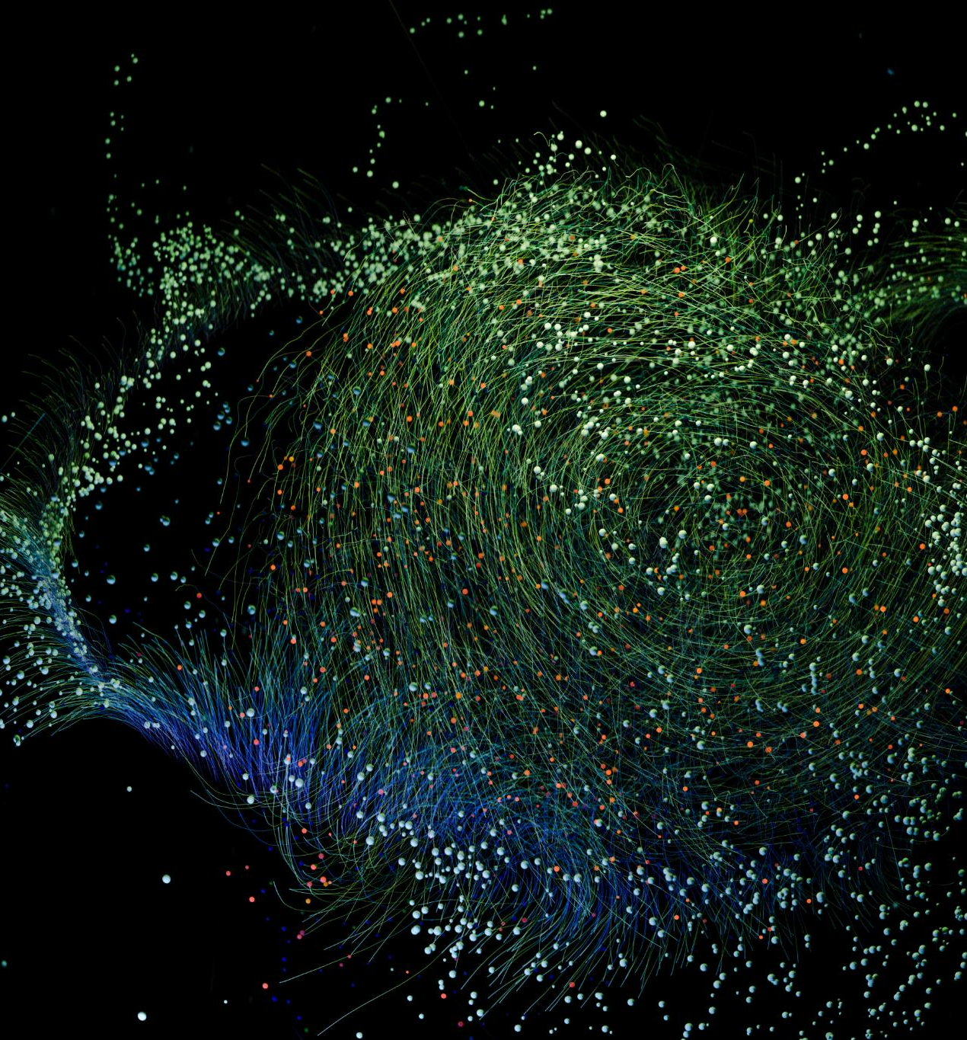
Outlier Identification
Outlier Detection
Outliers were identified within the dataset to ensure accurate analysis and modeling.
Impact Assessment
Assessment was conducted to understand how outliers affect model performance and data integrity.
Notes:
--- Outliers were detected and assessed to determine their impact on model performance and data integrity. Image source: Microsoft 365 content library

Slide 40

Exploratory Data Analysis — Trends
Landing success rates have risen significantly since 2013
Notable success rate differences across launch sites (KSC, CCAFS, VAFB)
Certain orbit types demonstrate higher landing success probabilities
Notes:
Analyzing landing success over time reveals improvement post-2013 due to operational enhancements. Site-specific differences highlight environmental and procedural impacts. Orbit types vary in difficulty, influencing landing probability.

Slide 41
Exploratory Data Analysis — Relationships
Experience effect shown by FlightNumber and LaunchSite interaction
PayloadMass varies with LaunchSite and Orbit, affecting landing
Detection of outliers and critical payload mass bands for performance
Notes:
Relationships among flight number, launch site, and payload help explain landing success variability. Identifying outliers and key payload ranges improves model robustness and informs risk assessments.

Slide 42

Exploratory Data Analysis Using SQL
Notes:
SQL queries were used to derive average success rates, common orbits, and payload statistics efficiently.

Slide 43

Average Success Rate by Launch Site
Data Aggregation Using SQL
SQL aggregation techniques were used to analyze landing success rates by launch site for accurate benchmarking.
Launch Site Performance Differences
Distinct success rates across launch sites highlight performance variations critical for decision making.
Benchmarking Success Rates
Understanding success rate differences supports effective benchmarking and continuous improvement of launch operations.
Notes:
SQL aggregation revealed launch site differences in landing success, aiding performance benchmarking.

Slide 44
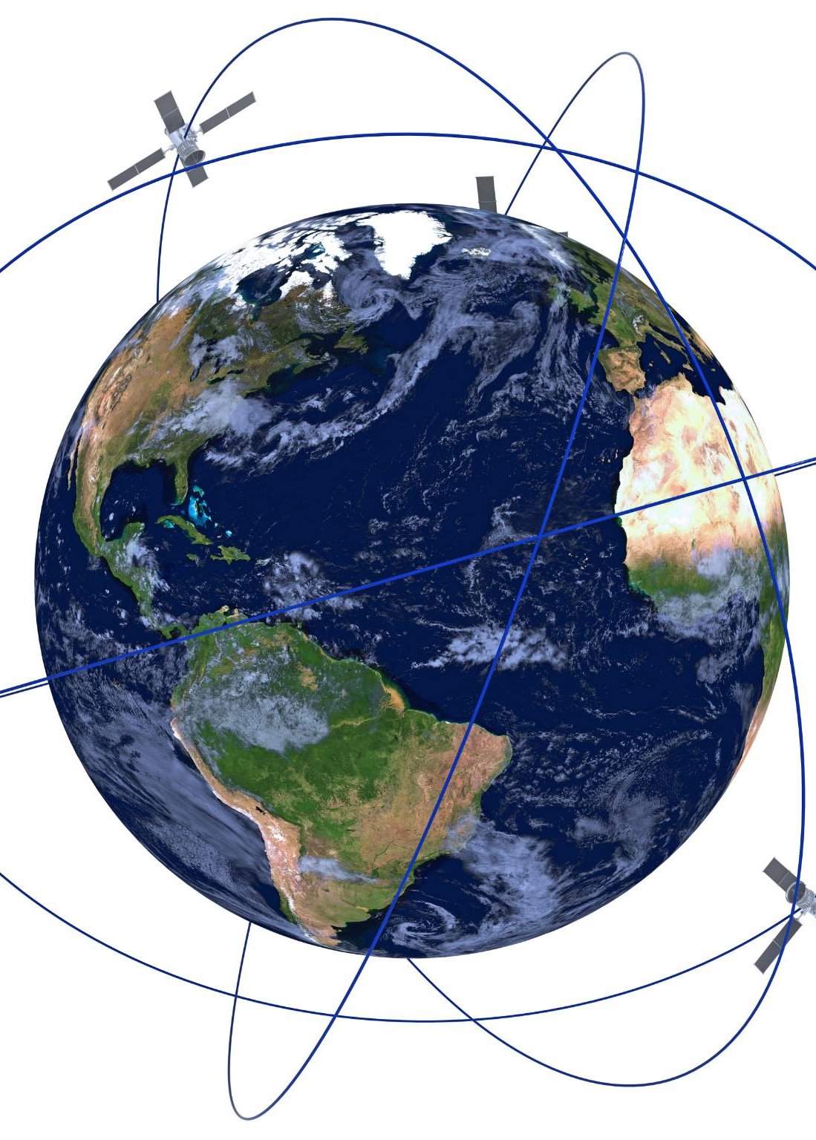
Most Frequent Orbits in Launches
Orbit Type Analysis
Examining the distribution of orbit types reveals common mission profiles in satellite launches.
Mission Profiles
Different orbit types correspond to specific mission goals and operational requirements.
Landing Relations
Understanding orbit types aids in planning landings and recovery of spacecraft.
Notes:
Orbit type distributions were analyzed to understand typical mission profiles and their relation to landings.

Slide 45
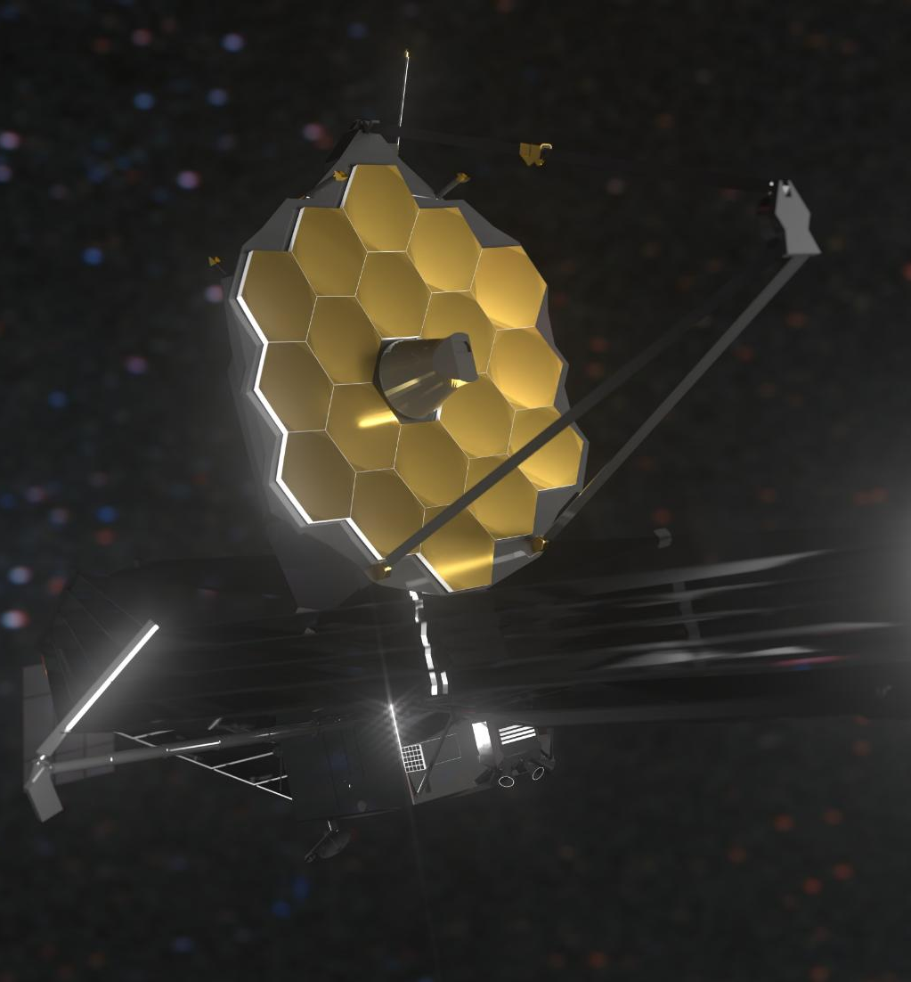
Average Payload Mass per Mission
Payload Mass Importance
Average payload mass indicates the complexity and scale of space missions, influencing design and planning.
Impact on Landing Success
Payload mass affects landing dynamics and success rates, requiring precise engineering and testing.
Notes:
Payload mass averages offer insight into mission complexity and potential impact on landing success.

Slide 46

Exploratory Data Analysis — SQL Insights
Ranking of unique launch sites by launch counts
Subqueries revealing max payload per booster version
Landing success vs failure trends by period, site, and orbit
Notes:
SQL queries provide detailed insights by summarizing launch site activity and payload capabilities across booster versions. Temporal and spatial landing success patterns support targeted operational improvements.

Slide 47
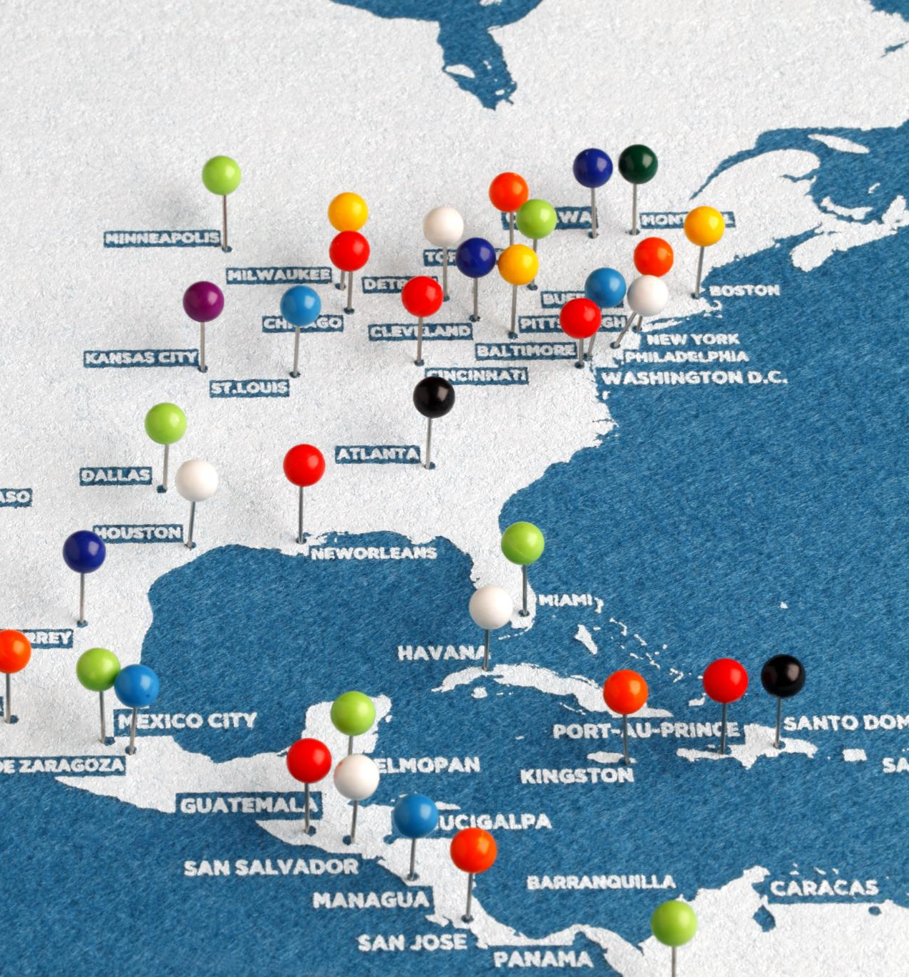
Folium Interactive Mapping
Maps proximity to coastline, highways, and railways for logistics
Distances to nearby cities visualize operational buffers
Supports risk assessment and emergency planning for landings
Notes:
Folium visualizations enable spatial analysis of landing sites relative to critical infrastructure. This mapping supports decision-making for site safety, recovery operations, and logistical planning.

Slide 48

Plotly Dash Dashboard Features
Filters include time range, launch site, and orbit type
Charts depict success share, yearly trends, and payload vs outcome
Dashboard provides dynamic insights for operational monitoring
Notes:
The Plotly Dash dashboard offers an interactive platform to explore key metrics related to landing success. Dynamic filtering allows users to tailor views by temporal, spatial, and mission characteristics.

Slide 49

Feature Engineering Techniques
One-hot encoding applied to categorical variables like Orbit and LaunchSite
Scaling and train-test splits with fixed seeds ensure reproducibility
Handling class imbalance improves model fairness and accuracy
Notes:
Proper feature engineering is essential to prepare data for machine learning. Categorical variables are encoded, numerical features scaled, and careful data splitting ensures robust model evaluation.

Slide 50

Modeling and Hyperparameter Tuning
Models tested: Logistic Regression, SVM, Decision Tree, KNN
GridSearchCV used to identify best hyperparameters per model
Accuracy employed as primary metric for model comparison
Notes:
Multiple supervised learning algorithms were trained and tuned using GridSearchCV to optimize model parameters. Accuracy guided model selection, balancing complexity and predictive performance.

Slide 51

Model Comparison Results
Best models achieved cross-validation accuracy above 80%
Winning model identified with optimal hyperparameters
Test set accuracy confirms generalization capability
Notes:
Comparative evaluation found a leading model with strong accuracy on both validation and test data. This slide summarizes model metrics and highlights the selected model and its parameters.

Slide 52

Confusion Matrix and Error Analysis
Precision and recall evaluated for landing success classification
False positives and false negatives analyzed for cost implications
Insights guide operational risk management and decision thresholds
Notes:
The confusion matrix reveals classification strengths and weaknesses. Understanding error types helps prioritize risk mitigation strategies and optimize threshold settings for operational use.

Slide 53
Conclusions and Business Impact
Public datasets enable robust landing success predictions
Key drivers include launch site, orbit type, and payload mass
Findings inform pricing strategies and mission risk management
Notes:
This project demonstrates how publicly available data can power accurate rocket landing predictions. Key influencing factors are identified, supporting better pricing, bidding, and risk decisions in space missions.

Slide 54

Next Steps for Model Improvement
Incorporate weather and wind data for enhanced precision
Add finer granularity on orbit and customer segments
Apply probability calibration and explore ROC/PR curves
Notes:
Future work includes integrating environmental factors and detailed mission profiles. Calibration techniques and advanced evaluation metrics will further elevate model reliability and operational value.

Slide 55

Predictors: Orbit, Launch Site, Payload Mass, etc.
Orbit Type
Different orbit types impact the landing trajectory and re-entry conditions of spacecraft.
Launch Site
The location of the launch site affects the initial launch trajectory and trajectory planning.
Payload Characteristics
Payload mass and configuration influence the vehicle's stability and landing performance.
Notes:
Features influencing the landing outcome include orbit type, launch site, payload characteristics, and more.

Slide 56
Variable Definitions and Types
Variable Definitions
Clear definitions for each variable ensure understanding and consistency in data analysis.
Measurement Units
Documenting measurement units ensures accurate interpretation and reproducibility of results.
Data Types
Specifying data types such as integer, float, and string helps maintain data integrity.
Notes:
Each variable's definition, measurement units, and data type are documented for clarity and reproducibility.

Slide 57

Conclusion
Robust Predictive Approach
Utilized diverse data sources and machine learning to accurately predict rocket landing outcomes.
Actionable Insights
Provided valuable insights to improve landing success through data-driven analysis.
Guidance for Future Improvements
Suggested enhancements including weather data integration and probability calibration for better accuracy.
Notes:
This report presents a robust approach to predicting Falcon 9 first-stage landing success using diverse data sources and machine learning. The findings provide actionable insights and guide future improvements including weather integration and probability calibration.

